Slide 1
SCANOPS TRAINING
All-Areas
Tutorial & Demo
QR • Marketing • Inventory • Warehouse • Equipment • Team • Settings
Notes:
Open by setting the expectation: this deck teaches navigation, transaction controls, and verification across the entire platform.
[Sources]
- User-provided ScanOps screenshots and SOP workflows from this project.

Slide 2
OPERATOR LEARNING
Training system
Learning path
•
Create and organize customer-facing QR codes
•
Operate inventory and warehouse transactions
•
Administer equipment, users, branding, billing, and support
•
Verify every action through preview, scan, status, or audit
Notes:
Use this slide to demonstrate the screen, then ask learners to identify the required verification before moving to the next workflow.
[Sources]
- User-provided ScanOps screenshots and SOP workflows from this project.

Slide 3
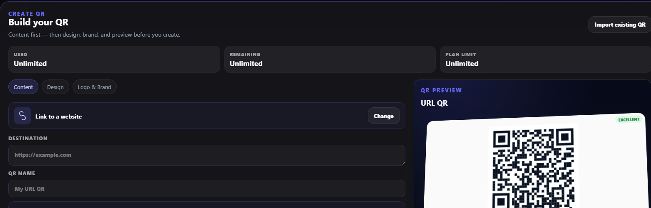
OPERATOR LEARNING
QR Codes
Create a QR that remains usable
•
Choose the destination type before designing
•
Use Trackable mode when scans and later destination changes matter
•
Set Advanced Language options for printed label and scan experience
•
Preview, test, and scan before publishing
Notes:
Use this slide to demonstrate the screen, then ask learners to identify the required verification before moving to the next workflow.
[Sources]
- User-provided ScanOps screenshots and SOP workflows from this project.

Slide 4
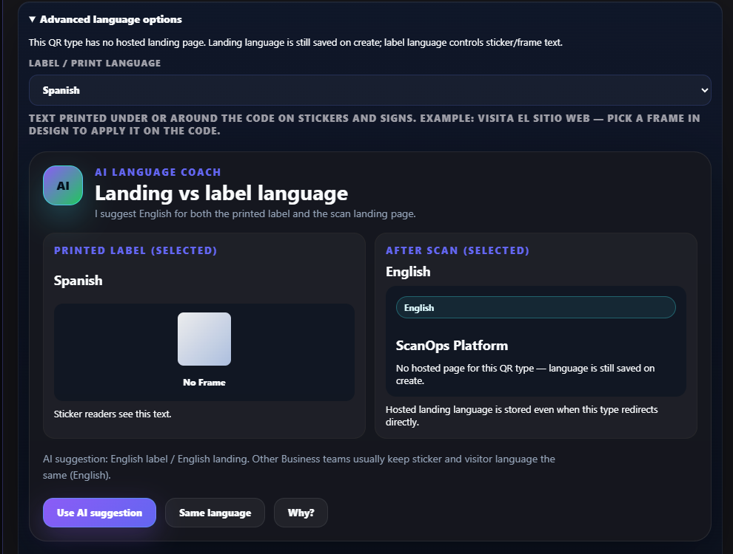
OPERATOR LEARNING
QR Codes
Advanced language keeps labels and visitors aligned
•
Select label/print language
•
Select landing or after-scan language
•
Use the AI language suggestion or intentionally keep languages different
•
Verify the printed frame text and hosted experience
Notes:
Use this slide to demonstrate the screen, then ask learners to identify the required verification before moving to the next workflow.
[Sources]
- User-provided ScanOps screenshots and SOP workflows from this project.

Slide 5
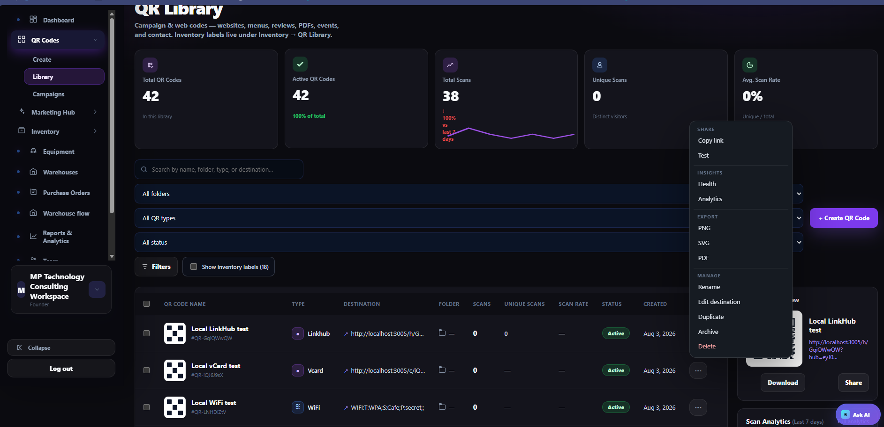
OPERATOR LEARNING
QR Library
The QR Library is the control center
•
Search by name, folder, type, or destination
•
Review scans, unique scans, status, and health
•
Use row actions to test, export, rename, edit, duplicate, archive, or delete
•
Download the correct production format
Notes:
Use this slide to demonstrate the screen, then ask learners to identify the required verification before moving to the next workflow.
[Sources]
- User-provided ScanOps screenshots and SOP workflows from this project.

Slide 6
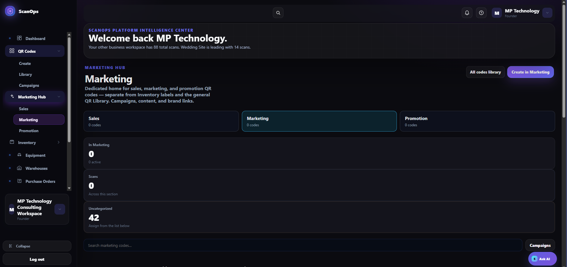
OPERATOR LEARNING
Marketing Hub
Sales, Marketing, and Promotion stay organized
•
Create campaign QR codes in the correct section
•
Keep these codes separate from inventory labels
•
Use the section counts and uncategorized queue to organize existing codes
•
Open the all-codes library when cross-section review is needed
Notes:
Use this slide to demonstrate the screen, then ask learners to identify the required verification before moving to the next workflow.
[Sources]
- User-provided ScanOps screenshots and SOP workflows from this project.

Slide 7
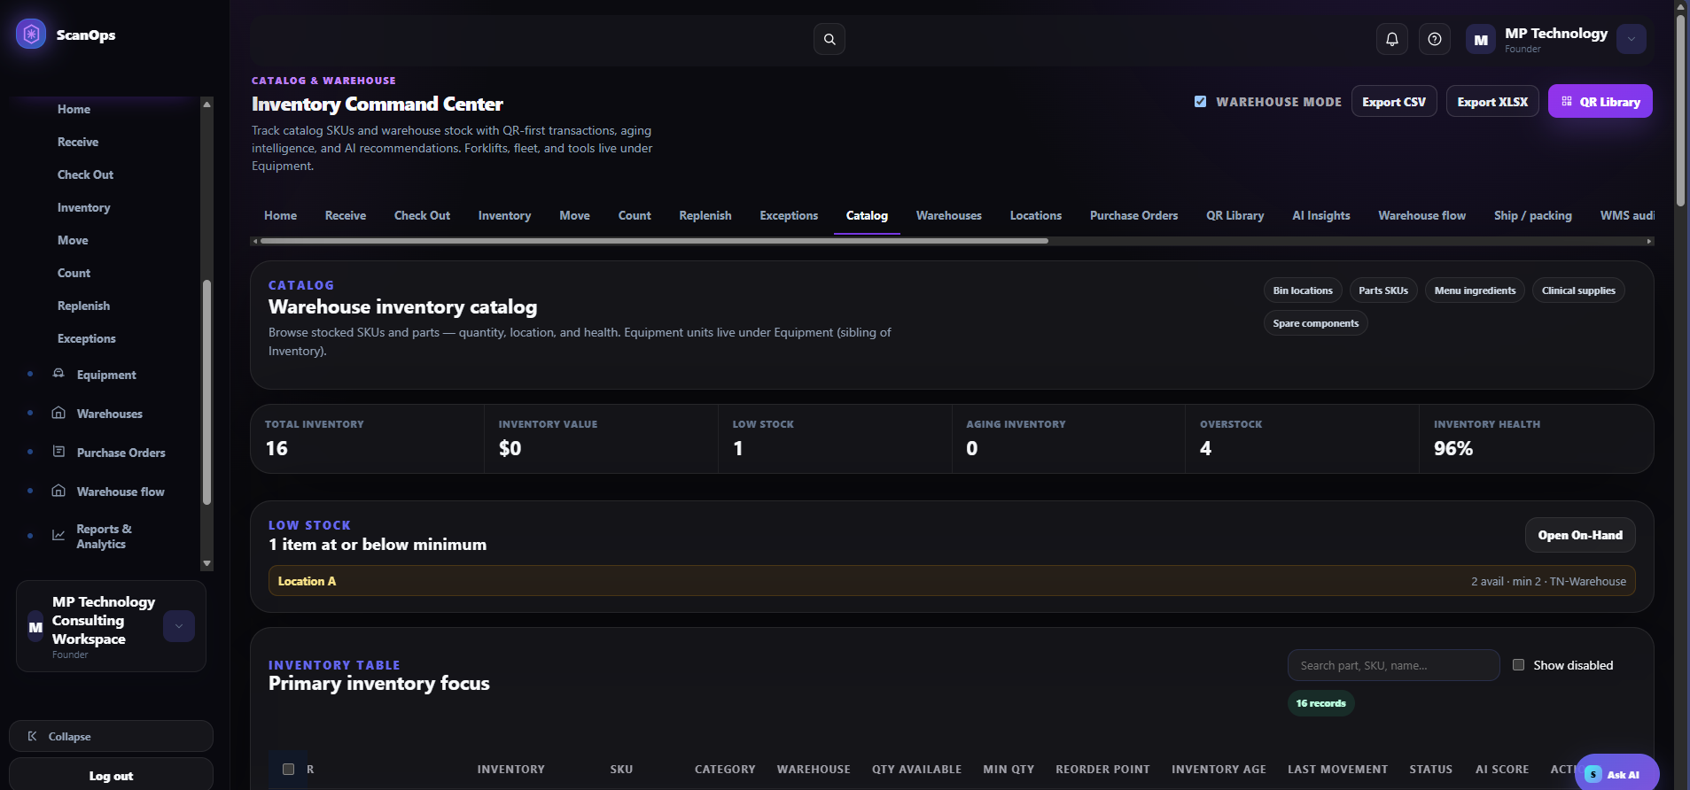
OPERATOR LEARNING
Inventory
Inventory starts with clean master data
•
Enable Warehouse Mode for location-managed stock
•
Create warehouses and locations before receiving
•
Create catalog records before adding quantity
•
Keep fleet, forklifts, and tools in Equipment—not stocked inventory
Notes:
Use this slide to demonstrate the screen, then ask learners to identify the required verification before moving to the next workflow.
[Sources]
- User-provided ScanOps screenshots and SOP workflows from this project.

Slide 8
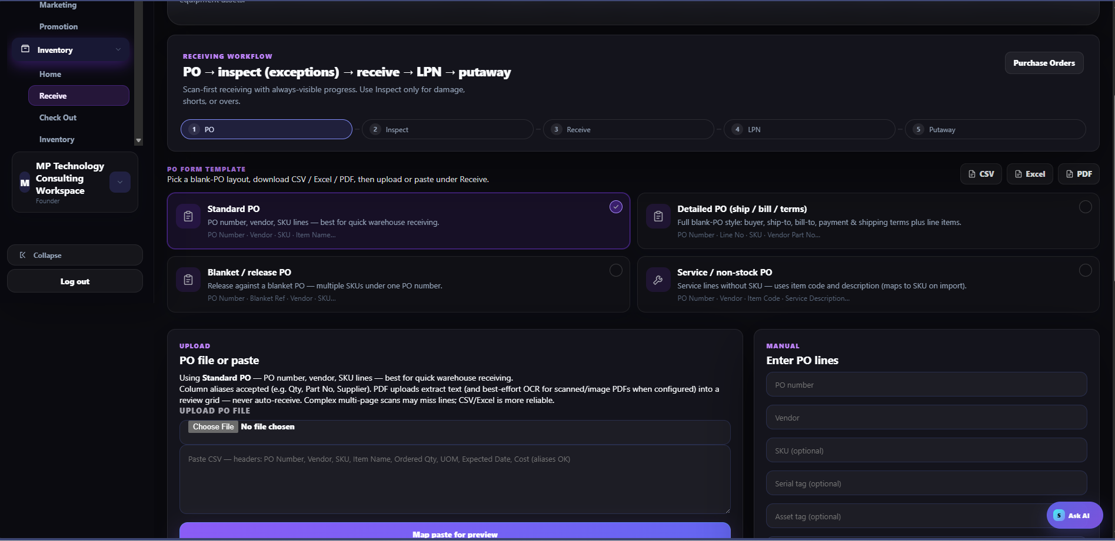
OPERATOR LEARNING
Receiving
Receive, label, and put away in sequence
•
Select or create the PO
•
Inspect shortages, overages, and damage
•
Receive the accepted quantity and generate an LPN
•
Print, scan-test, and put away before stock becomes available
Notes:
Use this slide to demonstrate the screen, then ask learners to identify the required verification before moving to the next workflow.
[Sources]
- User-provided ScanOps screenshots and SOP workflows from this project.

Slide 9
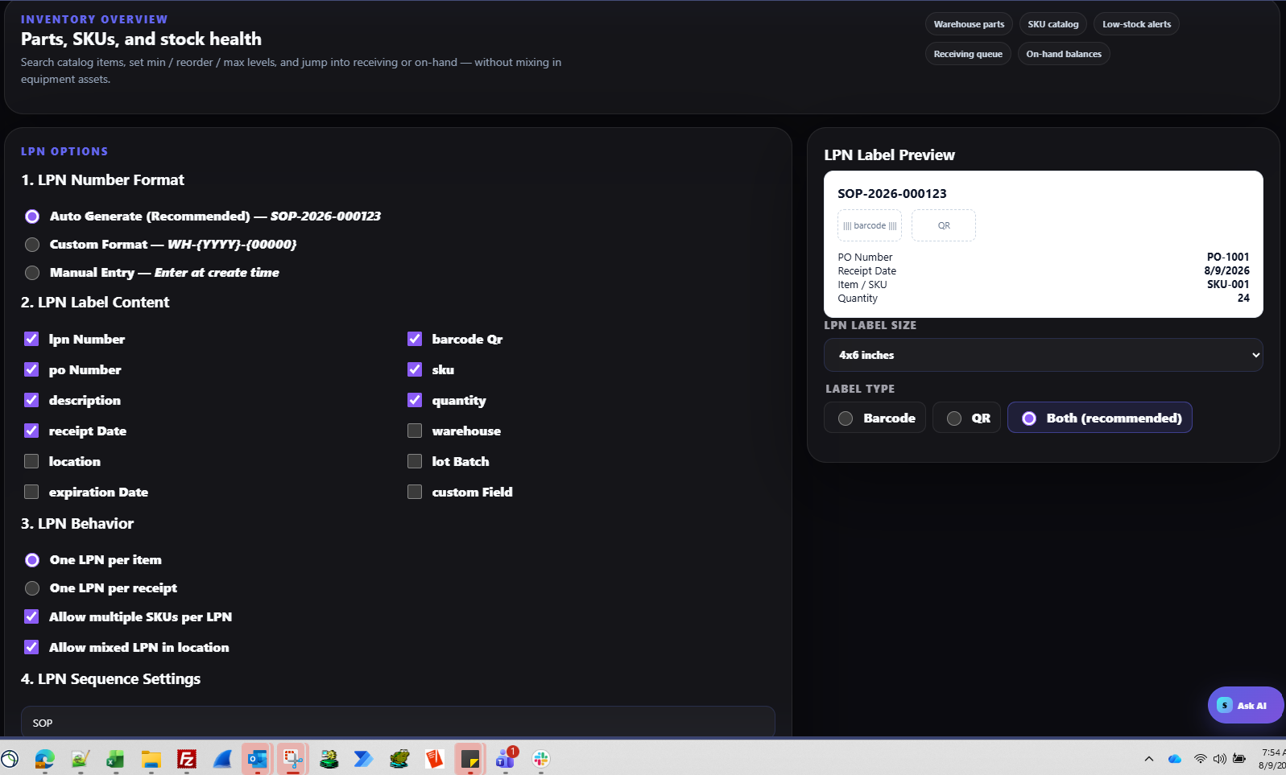
OPERATOR LEARNING
LPN
LPNs preserve container-level traceability
•
Auto-generate identifiers unless policy approves another format
•
Use barcode + QR when supported
•
Split or merge only compatible stock
•
Retire obsolete labels and verify new quantities
Notes:
Use this slide to demonstrate the screen, then ask learners to identify the required verification before moving to the next workflow.
[Sources]
- User-provided ScanOps screenshots and SOP workflows from this project.

Slide 10
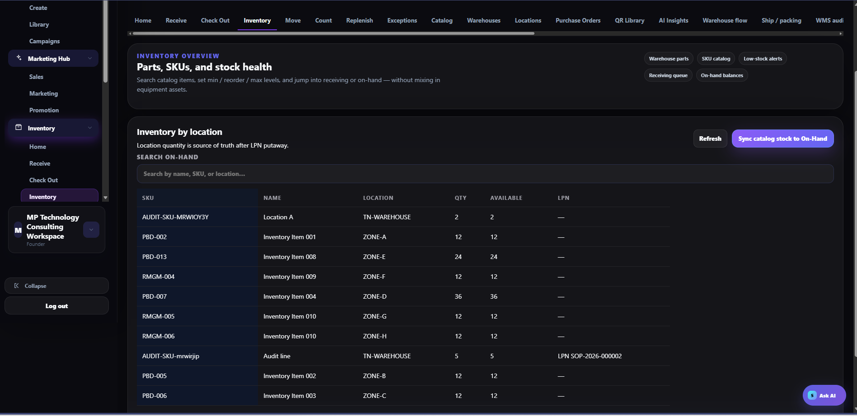
OPERATOR LEARNING
On-Hand
Location quantity is the source of truth
•
Use Inventory to review SKU, location, quantity, available quantity, and LPN
•
Use Move for internal relocation
•
Use Check Out for approved removal from a location
•
Never edit catalog quantity to correct a physical variance
Notes:
Use this slide to demonstrate the screen, then ask learners to identify the required verification before moving to the next workflow.
[Sources]
- User-provided ScanOps screenshots and SOP workflows from this project.

Slide 11
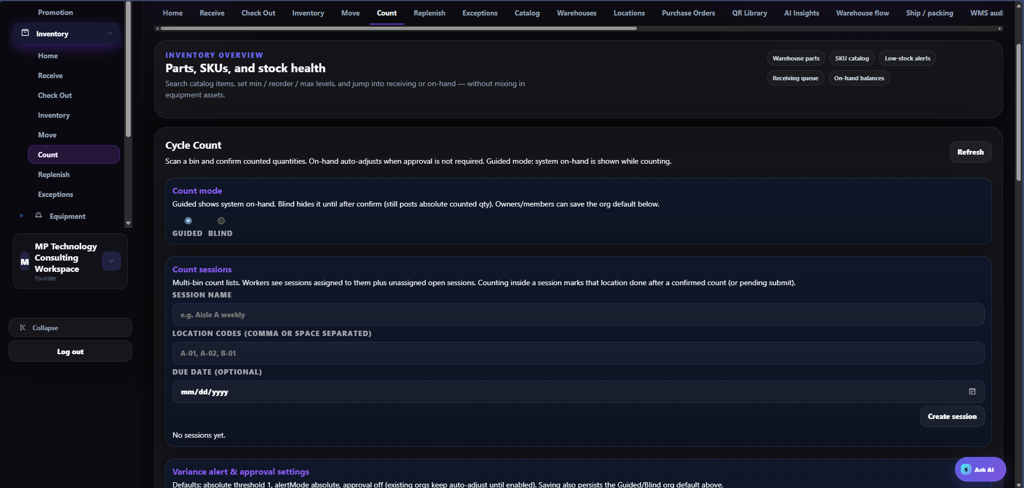
OPERATOR LEARNING
Cycle Count
Count, approve, and resolve variances
•
Choose Guided or Blind mode
•
Create location-based sessions and schedules
•
Require approval when segregation of duties matters
•
Route unexplained differences to Exceptions and WMS audit
Notes:
Use this slide to demonstrate the screen, then ask learners to identify the required verification before moving to the next workflow.
[Sources]
- User-provided ScanOps screenshots and SOP workflows from this project.

Slide 12
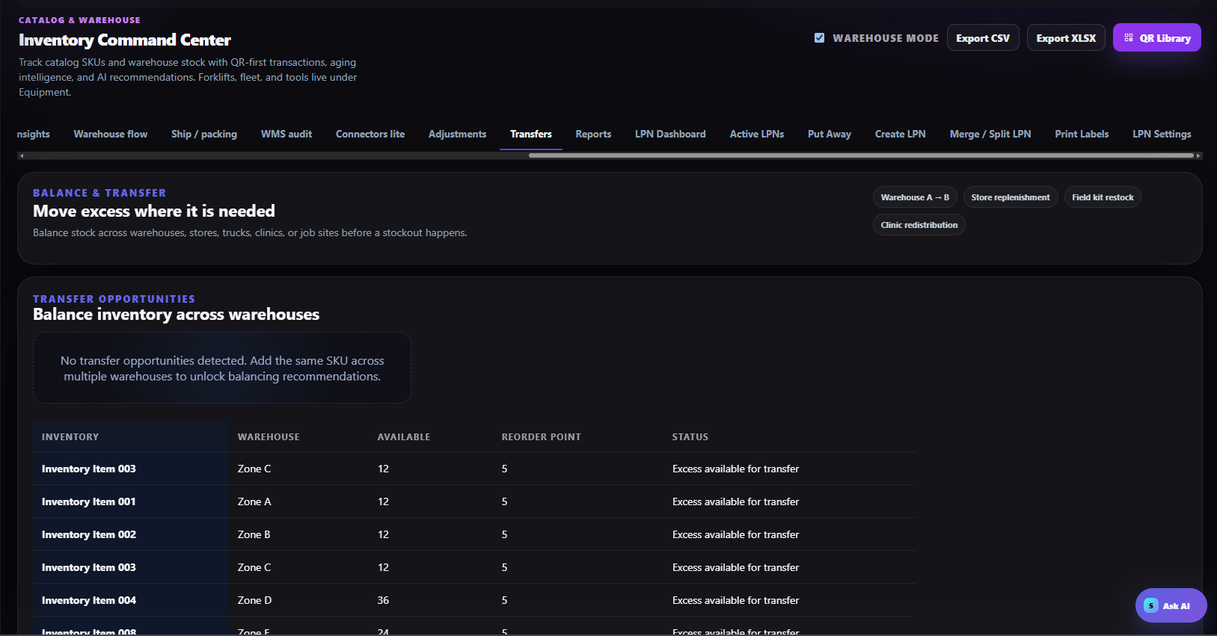
OPERATOR LEARNING
Inventory Control
Replenishment and transfer prevent stockouts
•
Review minimum, target, and available quantities
•
Confirm destination need and source availability
•
Move the exact quantity and close the task
•
Reconcile in-transit and received quantities before closure
Notes:
Use this slide to demonstrate the screen, then ask learners to identify the required verification before moving to the next workflow.
[Sources]
- User-provided ScanOps screenshots and SOP workflows from this project.

Slide 13
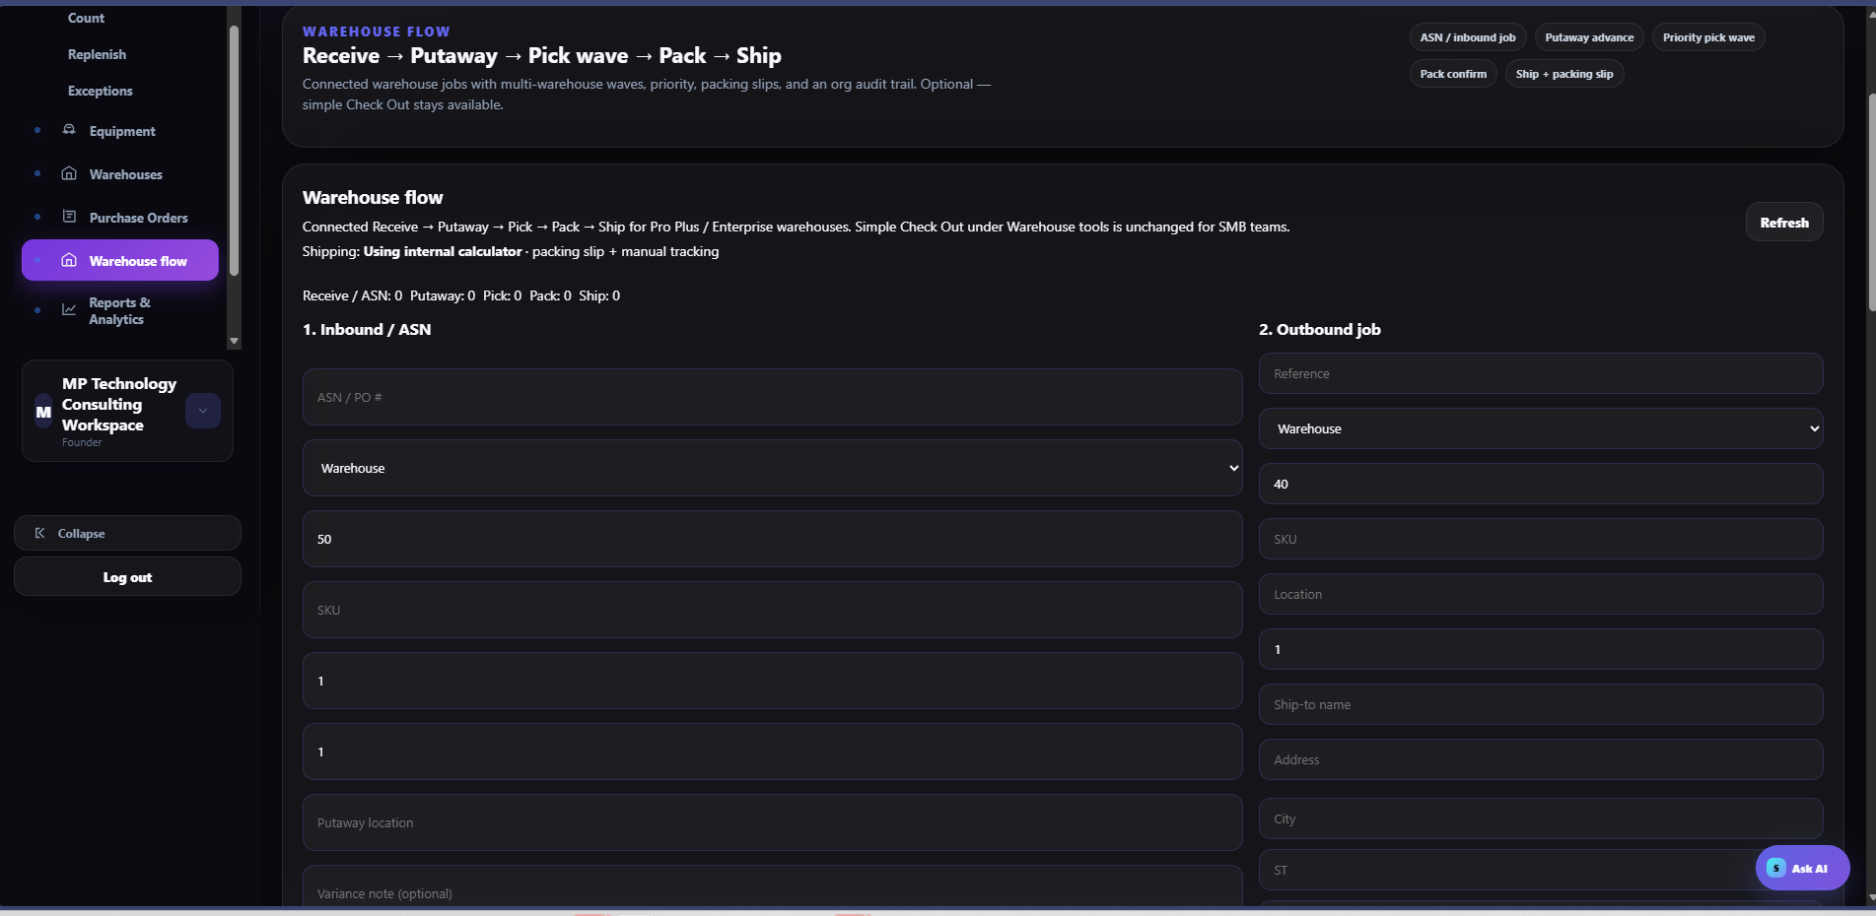
OPERATOR LEARNING
Warehouse Flow
The connected flow ends with verified shipment
•
Receive → Putaway → Pick wave → Pack → Ship
•
Scan source, item/LPN, and destination at each physical move
•
Use packing slips, approved rates, labels, and tracking
•
Record shift handoff and verify the audit trail
Notes:
Use this slide to demonstrate the screen, then ask learners to identify the required verification before moving to the next workflow.
[Sources]
- User-provided ScanOps screenshots and SOP workflows from this project.

Slide 14
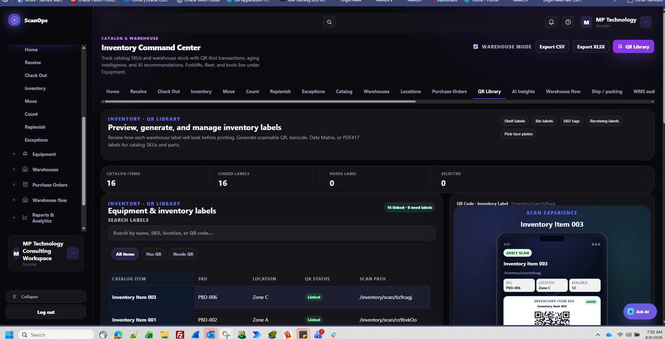
OPERATOR LEARNING
Inventory QR
Inventory QR labels belong in Inventory
•
Search items with or without linked QR labels
•
Preview SKU, location, and available quantity
•
Use the bulk wizard to select, template, preview, generate, and export
•
Scan-test labels before rollout
Notes:
Use this slide to demonstrate the screen, then ask learners to identify the required verification before moving to the next workflow.
[Sources]
- User-provided ScanOps screenshots and SOP workflows from this project.

Slide 15
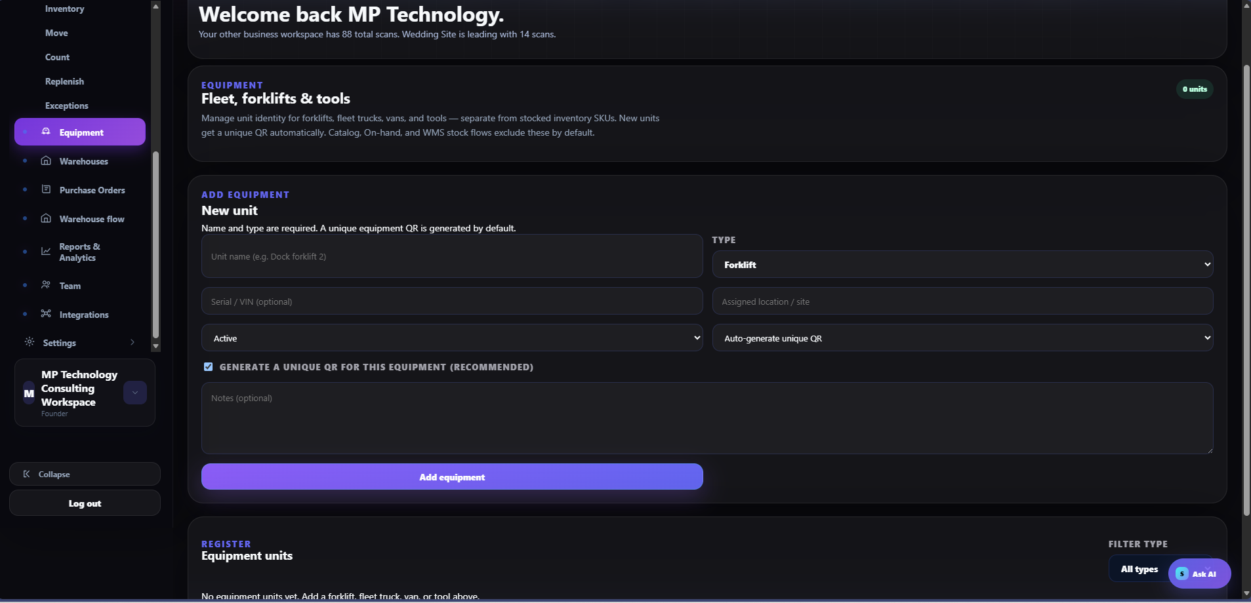
OPERATOR LEARNING
Equipment
Equipment is tracked one physical unit at a time
•
Enter a unique unit name and the correct type
•
Add serial/VIN, site, status, and notes
•
Auto-generate the unique equipment QR
•
Apply safely and confirm the scan opens the correct unit
Notes:
Use this slide to demonstrate the screen, then ask learners to identify the required verification before moving to the next workflow.
[Sources]
- User-provided ScanOps screenshots and SOP workflows from this project.

Slide 16
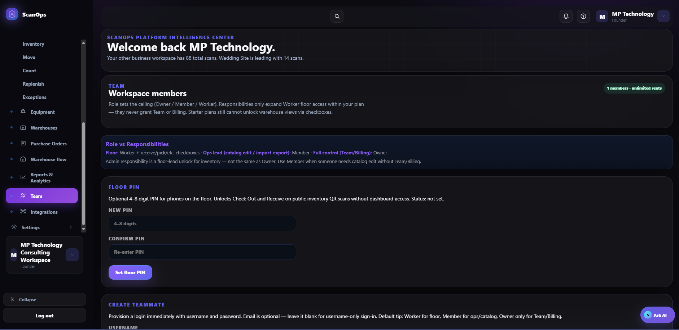
OPERATOR LEARNING
Team & Devices
Roles define the ceiling; responsibilities refine access
•
Worker for floor operations
•
Member for catalog, import/export, and QR administration
•
Owner only for Team and Billing
•
Use the Floor PIN only on approved shared devices
Notes:
Use this slide to demonstrate the screen, then ask learners to identify the required verification before moving to the next workflow.
[Sources]
- User-provided ScanOps screenshots and SOP workflows from this project.

Slide 17
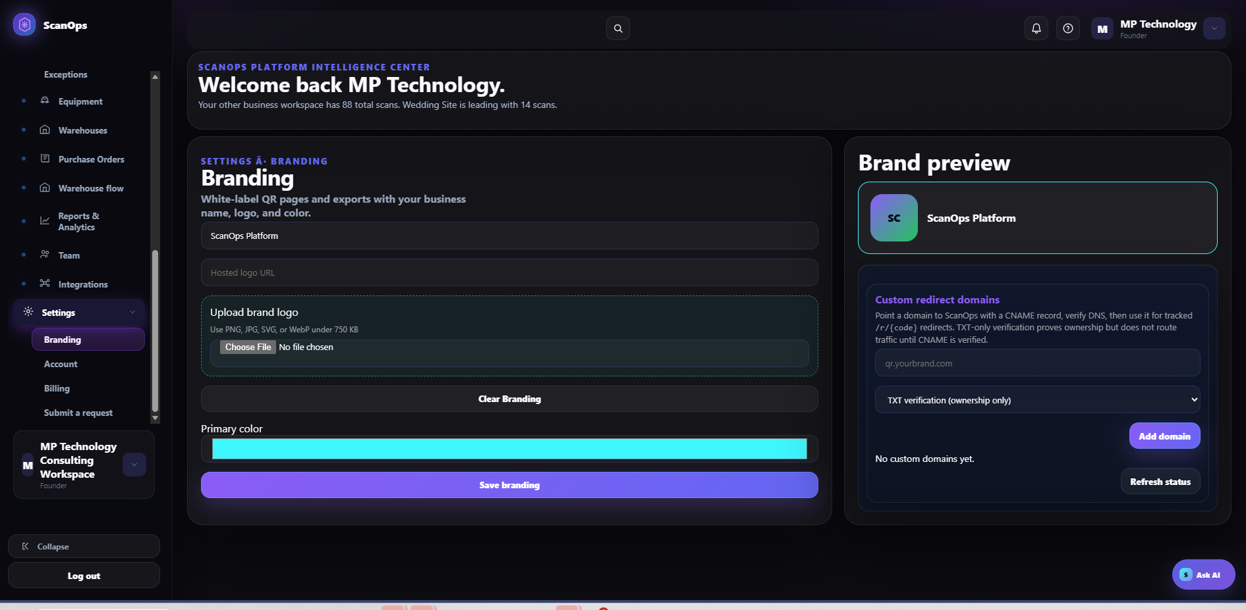
OPERATOR LEARNING
Settings
Branding must pass preview and live verification
•
Enter the approved business name
•
Upload an approved logo under the stated size limit
•
Set the approved primary color and review contrast
•
Verify DNS ownership and CNAME routing separately
Notes:
Use this slide to demonstrate the screen, then ask learners to identify the required verification before moving to the next workflow.
[Sources]
- User-provided ScanOps screenshots and SOP workflows from this project.

Slide 18
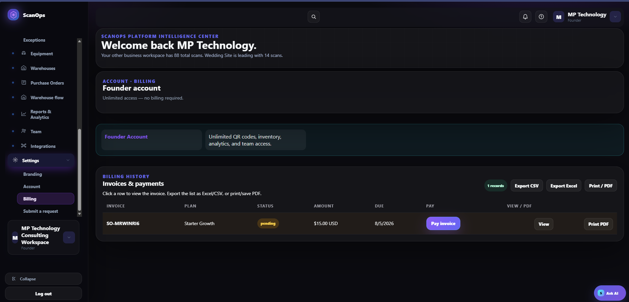
OPERATOR LEARNING
Billing
Billing requires approval, secure payment, and reconciliation
•
Review invoice number, plan, status, amount, currency, and due date
•
Open View before paying or filing
•
Submit payment once through the authenticated workflow
•
Confirm Paid status and reconcile the receipt
Notes:
Use this slide to demonstrate the screen, then ask learners to identify the required verification before moving to the next workflow.
[Sources]
- User-provided ScanOps screenshots and SOP workflows from this project.

Slide 19
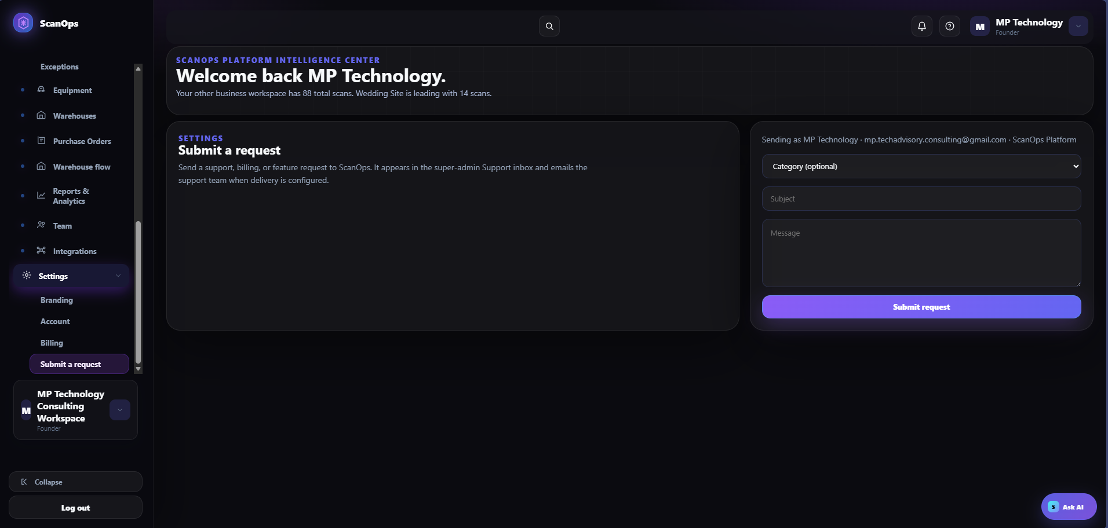
OPERATOR LEARNING
Support
A strong ticket is specific, reproducible, and secure
•
Choose the closest category
•
Use Area – Issue – Impact in the subject
•
Include expected vs. actual, steps, time, scope, and non-sensitive IDs
•
Never include passwords, PINs, API keys, or full payment details
Notes:
Use this slide to demonstrate the screen, then ask learners to identify the required verification before moving to the next workflow.
[Sources]
- User-provided ScanOps screenshots and SOP workflows from this project.

Slide 20
OPERATOR LEARNING
Operating Standard
Finish every task with verification
•
Confirm the correct workspace and record
•
Preview or scan before publishing
•
Match the physical action to the system transaction
•
Document exceptions, approvals, and handoffs
•
Use the audit trail to confirm completion
Notes:
Use this slide to demonstrate the screen, then ask learners to identify the required verification before moving to the next workflow.
[Sources]
- User-provided ScanOps screenshots and SOP workflows from this project.

